Slide 1
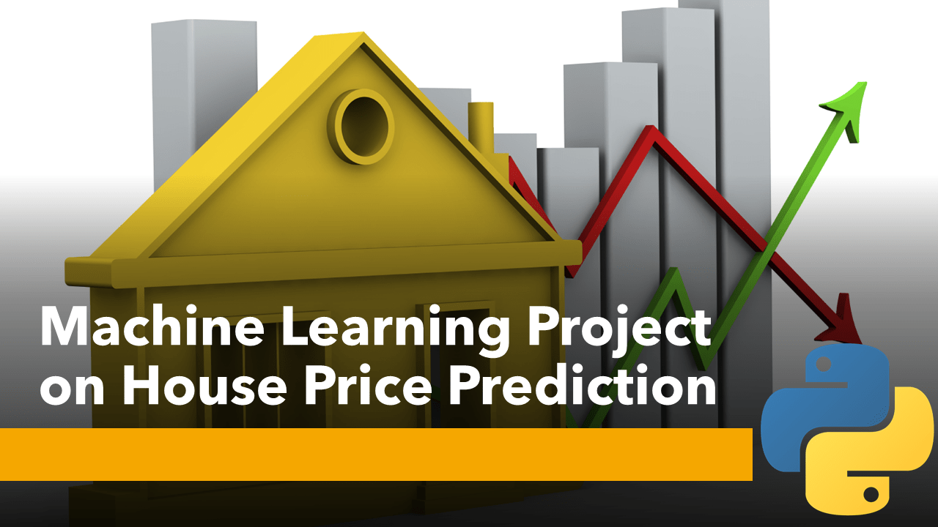
House Price Prediction Using Machine Learning
Team Members: 1.Samir Chakravarthy
2.Parnab Mukherjee
3.K Sai Chaitra

Slide 2
Objective
Objective: To develop a machine learning model for predicting house prices.
Why:
Assist potential buyers in estimating fair market values.
Aid sellers in setting competitive listing prices.
Enhance investment decisions for real estate professionals.
.

Slide 3
Problem Statement
The housing market is currently experiencing price fluctuations and instability, making it difficult to predict future trends accurately. Nevertheless, we will leverage linear regression and heatmaps as tools in this project to analyse and predict house prices. The project aims to address the challenge of predicting house prices by utilizing feature engineering, data pretreatment techniques, and a linear regression model, considering the volatility of the housing market.
To achieve the goal of predicting house prices, we will utilize a dataset containing relevant information from Kaggle (House price prediction | Kaggle). In order to develop an effective predictive model, we will employ data preprocessing techniques and construct a linear regression model. The linear regression model will enable us to forecast prices based on the given dataset. Linear regression models are versatile and widely applicable in situations where there is a linear relationship between the input variables and the target variable.

Slide 4
Data Collection
Data Sources: Kaggle(https://www.kaggle.com/datasets/neelkamal692/delhi-house-price-prediction)
Data Preprocessing: Cleaning, handling missing values, Visualization

Slide 5
Model Development
Machine Learning Algorithm: Linear Regression, Random Forest, XG Boost, Decision tree, K-nearest neighbor.
Training and Testing: Splitting the data into 20-80 ratio for training and testing.
Model Evaluation: We used R-squared to assess model performance.
Best Dataset: After evaluating all the datasets, we found that “XG Boost” has the best accuracy score

Slide 6
Results
[5595922
[5595922
Visualization: After taking the inputs from the dataset, the results is:
Actual Prices Predicted Prices
Rs. 5000000 Rs. 5595922

Slide 7


